Slide 1

Data Profiling and Progress Monitoring with Data Analytics Technique for...
A Non Gov’t Organization Established by the Archdiocese of Davao

Slide 2
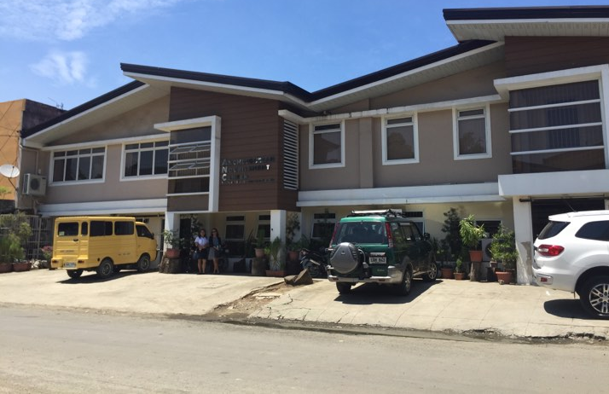

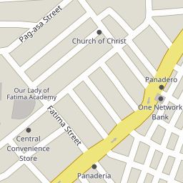
Pag-Asa St, Poblacion District, Davao City, Philippines

Slide 3
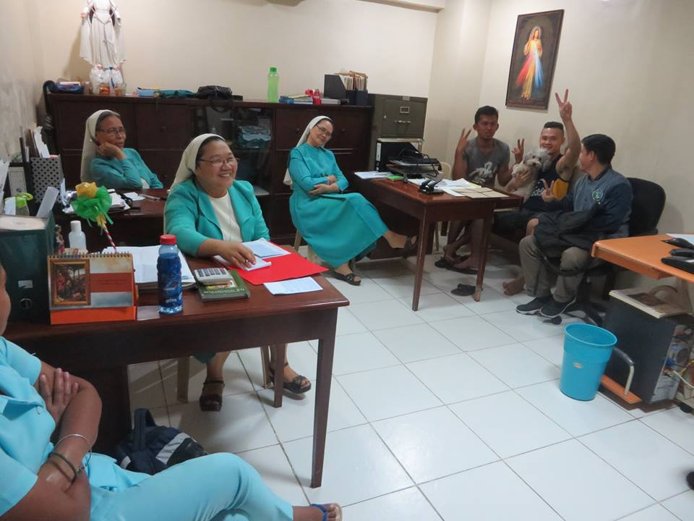
Pag-Asa St, Poblacion District, Davao City, Philippines

Slide 4

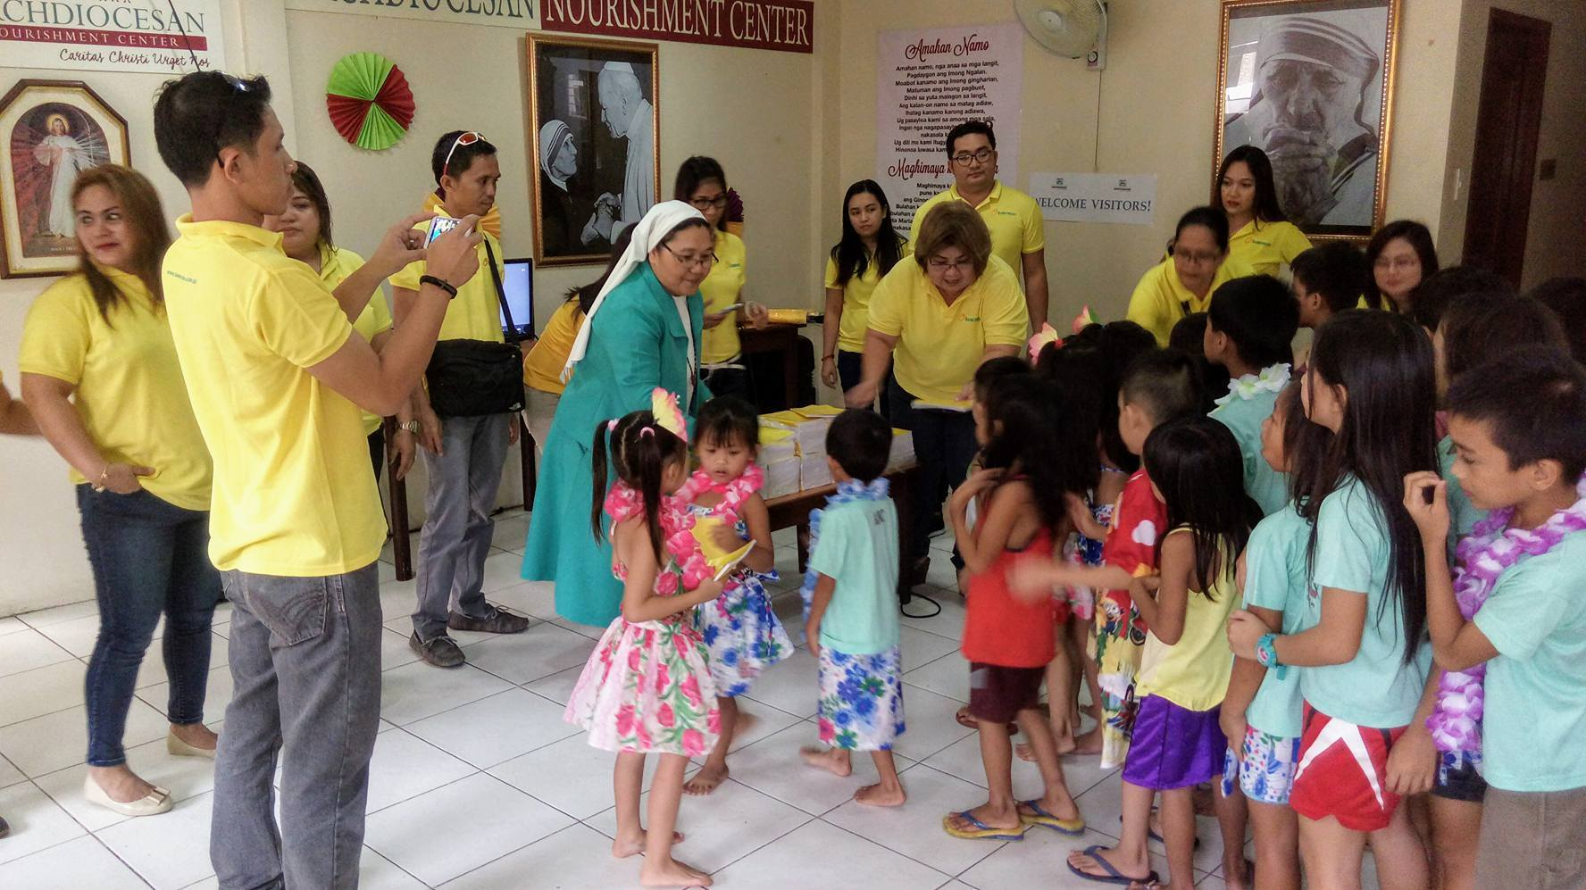
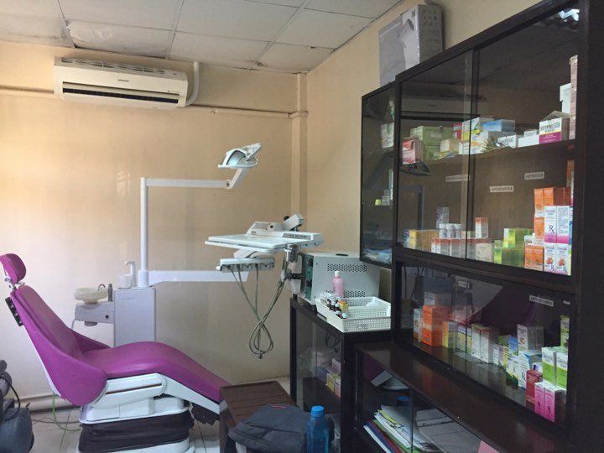
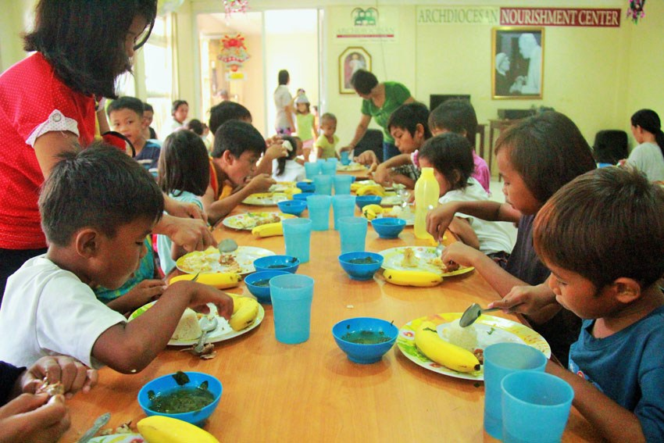

Slide 5
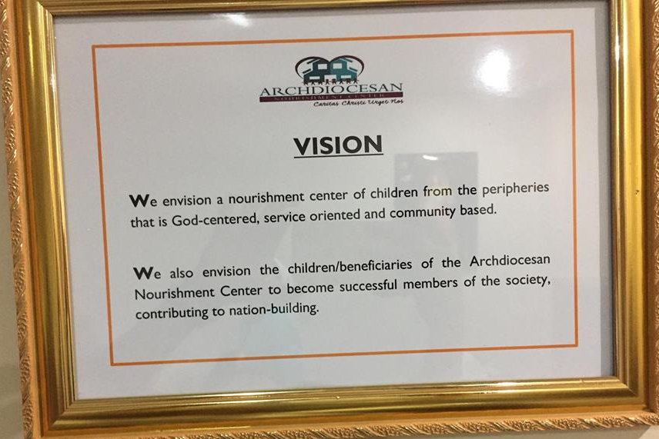
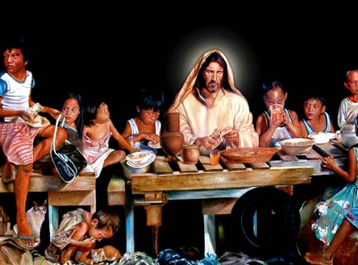
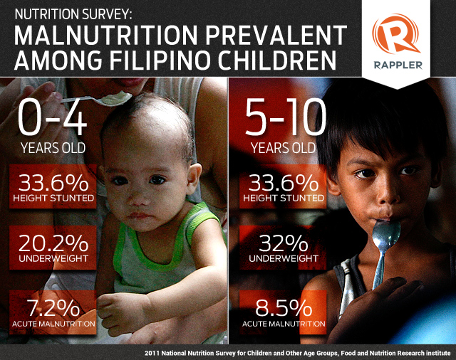
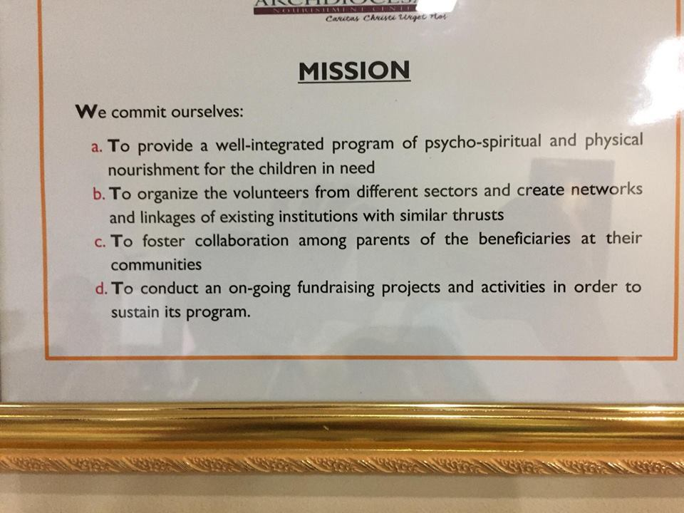

Slide 6

Problems
Difficulty in monitoring child’s nutritional progress
Difficulty in determining and comparing statistic reports
Difficulty in analyzing medical and nutritional status of children
Difficulty in determining children that requires the most medical attention and are in critical alert status.
Notes:
Difficulty in monitoring child’s nutritional progress
They record details such as height, weight, appetite, water intake, bowel movement and general hygiene, having all these details and having a lot of children to cater give them a hard time to organize and keep all the records. In every check-up, finding the previous record of each children consumes a lot of their time, there are also instances where the records are misplaced or loss so it is difficult to monitor their nutrition.
Difficulty in determining and comparing statistic reports
They do determine and compare statistic reports such as range of boys and girls enrolled in their nutritional program, diseases or illnesses by age in months, number of children with diseases, location affected by diseases, number of children that has improved or worsen their nutritional status, and comparison of diseases in every child. however it is difficult for them because of so much time and resources needed to perform the whole processes considering that they have lots of file stored in separate file storages.
Difficulty in analyzing medical and nutritional status of children
It is difficult for them to know if a certain disease of a child is recurring or not because they find it difficult to keep a report or disease history in order due to multiple files they store in separate file storages. It is also difficult for them to analyze why the BMI of a child increases or decreases and what are the possible causes for these children’s nutritional problems.
Difficulty in determining children that requires the most medical attention and are in critical alert status.
There are cases when a child requires immediate medical attention due to various reasons like worsen nutritional status, illnesses, loss of appetite, etc. Sometimes, they have difficulty in monitoring such cases because each of these records requires assessment by looking at their previous data which are stored separately. Moreover, they currently don’t have a notification device or technology for such cases

Slide 7

Specific Objectives
Analyze the medical and nutritional status
of the Archdiocesan Nourishment Center (ANC)
children using Data Analytics Techniques.
Generate recommendations for possible treatment and proper nutritional diet using Decision Support System.
Generate statistical reports in graphical representation using Highcharts Interactive JavaScript charts.
Notify the medical staffs regarding children that requires immediate medical attention, prioritization and medical schedules using JQUERY tool.
Notes:
Difficulty in monitoring child’s nutritional progress
They record details such as height, weight, appetite, water intake, bowel movement and general hygiene, having all these details and having a lot of children to cater give them a hard time to organize and keep all the records. In every check-up, finding the previous record of each children consumes a lot of their time, there are also instances where the records are misplaced or loss so it is difficult to monitor their nutrition.
Difficulty in determining and comparing statistic reports
They do determine and compare statistic reports such as range of boys and girls enrolled in their nutritional program, diseases or illnesses by age in months, number of children with diseases, location affected by diseases, number of children that has improved or worsen their nutritional status, and comparison of diseases in every child. however it is difficult for them because of so much time and resources needed to perform the whole processes considering that they have lots of file stored in separate file storages.
Difficulty in analyzing medical and nutritional status of children
It is difficult for them to know if a certain disease of a child is recurring or not because they find it difficult to keep a report or disease history in order due to multiple files they store in separate file storages. It is also difficult for them to analyze why the BMI of a child increases or decreases and what are the possible causes for these children’s nutritional problems.
Difficulty in determining children that requires the most medical attention and are in critical alert status.
There are cases when a child requires immediate medical attention due to various reasons like worsen nutritional status, illnesses, loss of appetite, etc. Sometimes, they have difficulty in monitoring such cases because each of these records requires assessment by looking at their previous data which are stored separately. Moreover, they currently don’t have a notification device or technology for such cases

Slide 8

Review of Related Literature
2.7 Big Data Analytics in
Healthcare: Promise and Potential
2.4 A Platform For Secure
Monitoring And Sharing of
Generic Health Data In The Cloud
2.1 GEMINI: An Integrative
Healthcare Analytics System

Slide 9
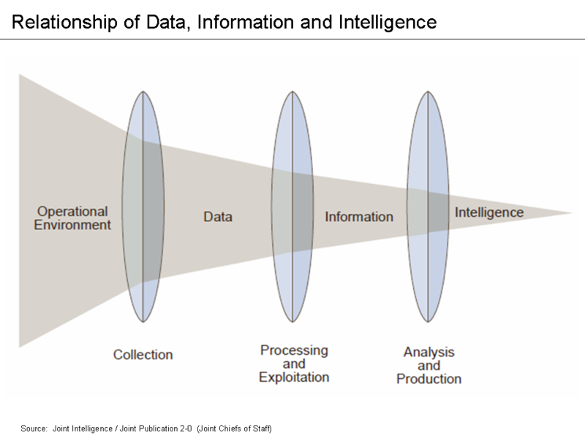

Slide 10
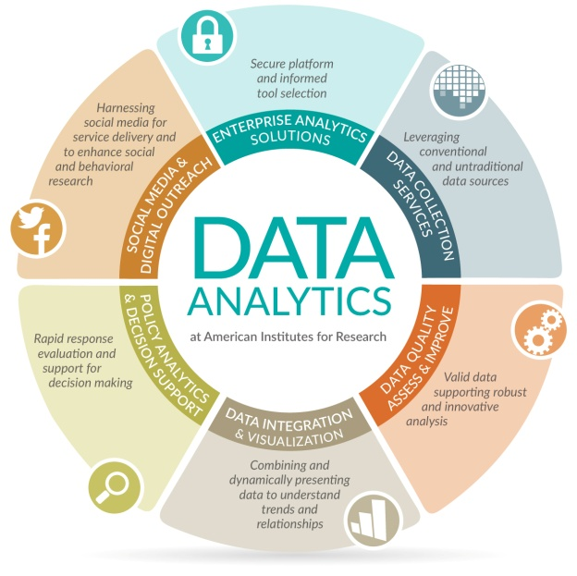
Data Analytics
Definition - What does Data Analytics mean?
Data analytics refers to qualitative and quantitative techniques and processes used to enhance productivity and business gain. Data is extracted and categorized to identify and analyze behavioral data and patterns, and techniques vary according to organizational requirements.
Data analytics is also known as data analysis.
Source: https://www.techopedia.com/definition/26418/data-analytics

Slide 11
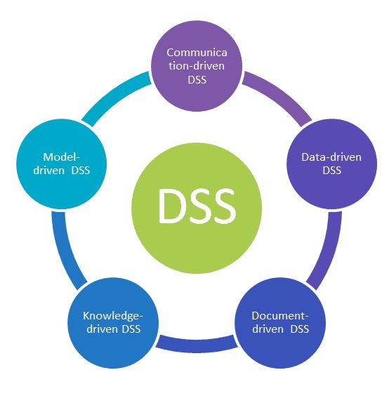
Decision Support System (DSS)
Definition - What does DSS mean?
Decision Support System (DSS) is a computer program application that analyzes business data and presents it so that users can make business decisions more easily. It is an "informational application" (to distinguish it from an "operational application" that collects the data in the course of normal business operation).
Source: http://searchcio.techtarget.com/definition/decision-support-system

Slide 12
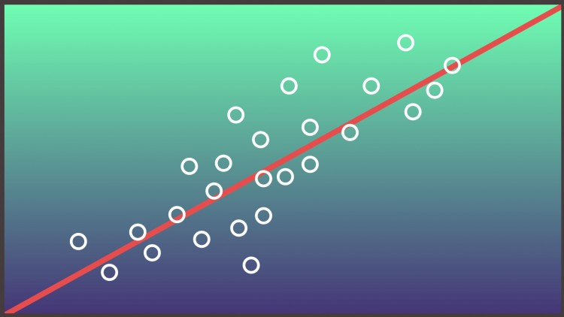
Regression Analysis
What is Regression Analysis
Regression analysis is a way of mathematically sorting out which of those variables does indeed have an impact. It answers the questions: Which factors matter most? Which can we ignore? How do those factors interact with each other? And, perhaps most importantly, how certain are we about all of these factors?
Source:
https://hbr.org/2015/11/a-refresher-on-regression-analysis

Slide 13
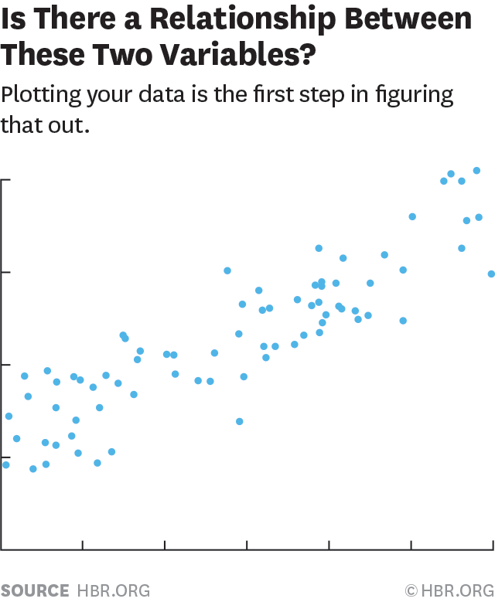
Example
The y-axis is the amount of BMI index decrease ratio in percentage (the dependent variable) and the x-axis is the attendance per day percentage. Each blue dot represents one month’s data—how much absences and falling nutritional status percentage they had the same month. Then come up with conclusion regarding the effectiveness of their current programs

Slide 14
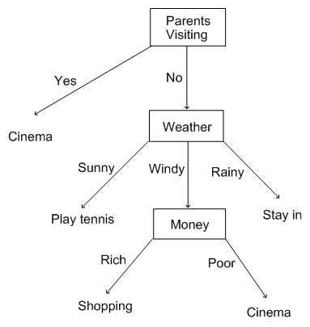
Decision Tree Analysis
What is Decision Tree Analysis
A decision tree (as a predictive model) to go from observations about an item (represented in the branches) to conclusions about the item's target value (represented in the leaves). It is one of the predictive modelling approaches used in statistics, data mining and machine learning.
Source:
http://study.com/academy/lesson/what-is-a-decision-tree-examples-advantages-role-in-management.html

Slide 15
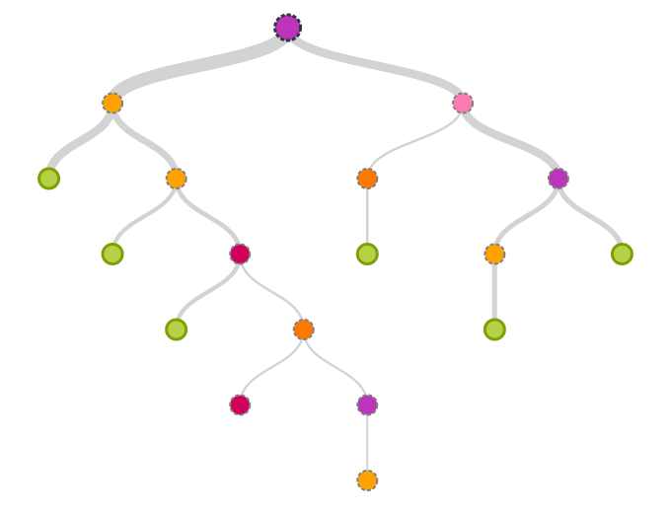
Example
A child has a failing nutritional status and considered as severely underweight (acute malnourished). The system will find out what are the possible causes based on various factors leveled accordingly by their significance. Illnesses, Appetite, Water Intake, Bowel Movement, General Hygene, Behaviour, Environment, etc.

Slide 16
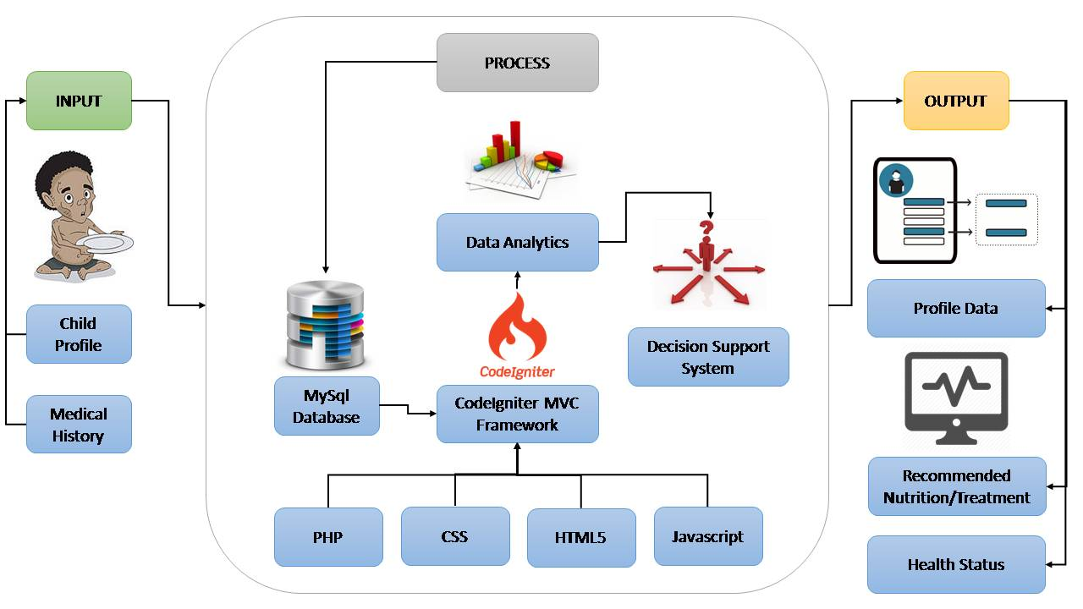
Conceptual Framework

Slide 17







Data Analytics and Decision Support Process
RAW DATA
Child Information
Profile
Height & Weight
Appetite
Water Intake
Bowel Movement
General Hygene
Illnesses
Concerns
Household Information
Family Members
Background Information
Financial Status
Residence
Family Concerns
Medical History
World Health Organization (WHO) Filipino Child Growth Standard
and
Standard Dietary Guidlines
Data Analytics
Data Extraction
Categorization
Comparison
Identification
Analyzation
Decision Support – recommendations/actions to be taken,
Notifications,
Graphical Statistics, and
Reports

Slide 18


System’s Infrastructure
Routes
INPUT
Request
CONTROLLER
PHP
Database
VIEW
HTML5
CSS
Javascript
Libraries
Highcharts JS
TypeAhead JS
Datatables
Bootstrap
MPdf
MODEL
PHP
MySQL
OUTPUT

Slide 19




Current System
Center
Child Information Sheet (CIS)
Household Information Sheet (HIS)
Visit the physician if necessary (child is not feeling well)
Weight & Height Monitoring / BMI Status (Monthly)
Home Visitation Interview (Quarterly)

Slide 20
Proposed Data Profiling and Progress Monitoring System
Center
CIS & HIS Form
Data gathered are encoded on the system for storage and Data Analytics
Monthly Monitoring
Quarterly Monitoring
Reports, Child Profile, Decision Support, Statistics, Notifications
Physician Findings

Slide 21

Detailed System Features
Notifications for Deworming status (Jan and July),
unmonitored monthly, severe conditions,
flagged due to various remarks.
Number of current illnesses by location in graphical
(Is there an outbreak?) ex. Diarrhea, dengue, etc.
Statistics for number of benificiaries, illnesses recorded, classifications based on nutritional status (N, UW, SU, St, W).
Assessment of other factors such as attendance, attitude, parents, environment, etc. To determine which of them requires counselling.

Slide 22
Detailed System Features
Illnesses monitoring with history within anc. Also
records past illnesses, serves as guidlines for
causes of malnutrition.
Provide suggested medications for fluctuating
nutrional status.
Monitoring of trends for various scenarios such as alarming number of children with illnesses at the same time, absences, malnourishment.

Slide 23
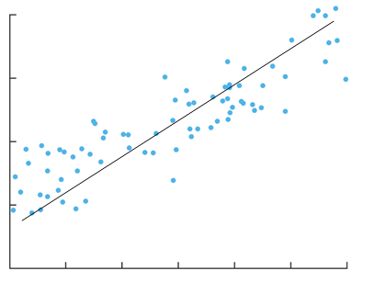
10 20 30 40
BMI Index Decrease Ratio %
10 20 30 40 50 60
Attendance (Absences %)

Slide 24
A Child has Failing Nutritional Status
No
Yes
Good (Stable or Improving)
Child’s Appetite
Normal
Bad
Good
Check child to improve appetite
Child is Not Feeling Well
Child’s Water Intake
Yes
Bad
Provide Medical Attention
(See Physician)
No
Normal
Educate and assess to improve
Check Other Issues (Counselling)
Child’s Bowel Movement

Slide 25
Table 1:
Age (Months) | Height(cm)
 | Severely Stunted | Stunted |  | Normal |  | Tall
 |  | From | To | From | To
 | <-3SD | -3SD | <-2SD | -2SD | +2SD | >+2SD
36 | 84.9 | 85.0 | 88.6 | 88.7 | 103.5 | 103.6
48 | 90.6 | 90.7 | 94.8 | 94.9 | 111.7 | 111.8
Table 2:
Age (Months) | Weight(cm)
 | Severely Under- weight | Underweight |  | Normal |  | Over Weight
 |  | From | To | From | To
 | <-3SD | -3SD | <-2SD | -2SD | +2SD | >+2SD
36 | 9.6 | 9.7 | 10.7 | 10.8 | 18.1 | 18.2
48 | 10.9 | 11.0 | 12.2 | 12.3 | 21.5 | 21.6

